Slide 1

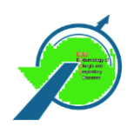
METHODOLOGY FOR PHENOTYPING
HEALS INTERNAL EXPOSOME MARKERS LJUBLJANA, 26-28.V.2014
www.heals-eu.eu
E
P
A
R

Slide 2
Methodology for phenotypying / endotyping
Stream 5 / WP 16

Slide 3
Phenotyping is an unsupervised classification problem
We have observed (measured) several characteristics from different individuals
Let’s try to put it in an equation what “phenotype” means:
genotype (G) + environment (E) + genotype-environment interactions (G-E) → phenotype (P)
We want to see WHICH similarities (multidimensional) among these characteristics that strongly bind the ‘hidden’ or ‘latent’ groups that we are trying unravel

Slide 4
Cluster analysis
The underlying idea is to find an optimum no. of groups (syn. clusters) that will resemble strongly in characteristics WITHIN a group, and contrast maximally BETWEEN groups
A first trade-off is to find the “ideal no. of groups” that correspond to something meaningful (interpretation) or useful (health impacts)
This contrasts with the supervised learning where we already know a priori the no. of groups that exist !
A second trade-off is to find the “probability or weight” that an individual belongs to a certain ‘latent’ group
The main problem lies in the fact that we have to determine these 2 pieces of the puzzle jointly, and not one by one

Slide 5
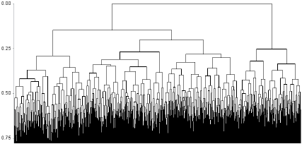
Different classical clustering methods
Agglomerative hierarchical classification (AHC) – bottom-up approach
Ward’s method (to maximise between and minimise within variability)
Average linkage, complete linkage, ...
k-means clustering – assume the no. of clusters = k and then determine, which k best fits the data

Slide 6
More on clustering / segmentation
Cobweb – tree-based method
Expectation-Maximisation (EM)
Learning Vector Quantisation (LVQ)
Kohonen’s Self-Organising Map (SOM)
Support Vector Clustering (SVC)
Top-down approach (compared to AHC)
Fuzzy c-means clustering
Self-Organising Tree Algorithm (SOTA)
And, quite a few other methods, options ...

Slide 7
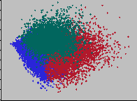
Cluster validation
Achtung! the no. of clusters are often very sensitive to the method and tuning parameter(s) (e.g., kernel type, distance type) chosen !
Stability of clusters identification must be ensured
Criterion-based validation
Entropy
SSE
Cross-Validation (CV)
Check Discriminant Analysis (DA) a posteriori
Compare error rates vs. CV error rates

Slide 8
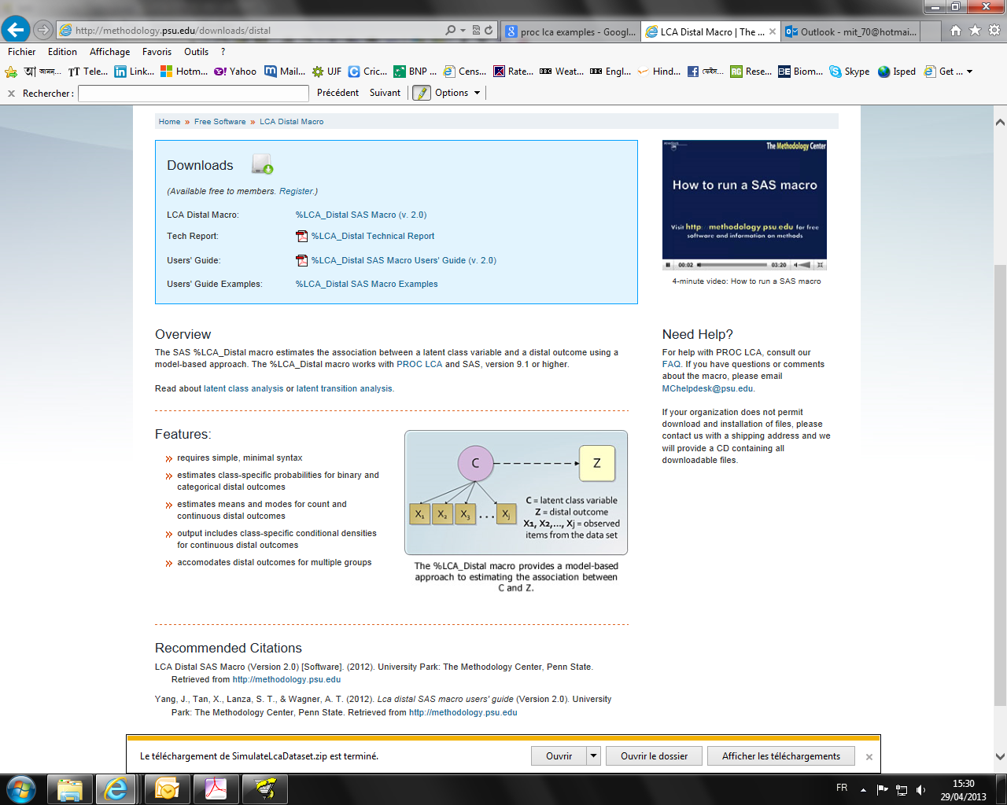
Latent Class Analysis (LCA)
If the X₁ ... X_{j} (predictor) variables are categorical, and the no. of ‘latent’ categories of the variable C are selected by some goodness-of-fit (GoF) criterion
Then the effects of X₁ ... X_{j} variables can be thought to be exerted by the latent variable C on the distal (outcome) variable
It is a sort of variable reduction to a lower dimensional framework, analogical to the ‘hidden’ nodes of a neural network

Slide 9
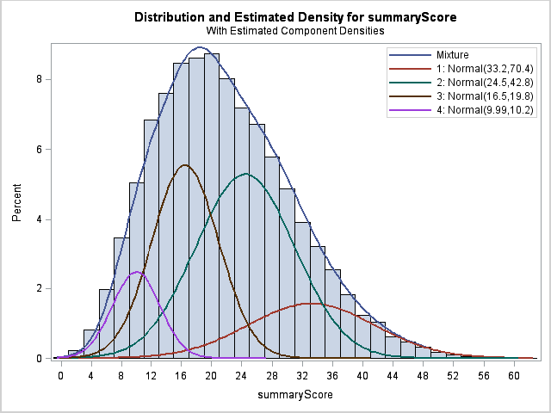
Finite Mixture Model (FMM)
If the outcome distribution comes from a mixture of ‘latent’ categories, the FMM approach can divide the distribution into k more homogeneous categories using EM algorithm / MCMC
Gaussian mixture model (GMM) is a special case of FMM

